Slide 1

Shiro Inventory System
Simplify inventory management for any organization.
Shiro Inventory is a cloud-based inventory management system
designed to streamline operations, reduce waste, and empower
businesses to make better decisions.
By Wanjiru Maina

Slide 2
The Inventory Problem
Manual Processes
Overstocking/Understocking
Lack of Visibility
Time-consuming and prone to errors.
Difficult to track inventory levels and make informed decisions.
Leads to financial losses and customer dissatisfaction.

Slide 3
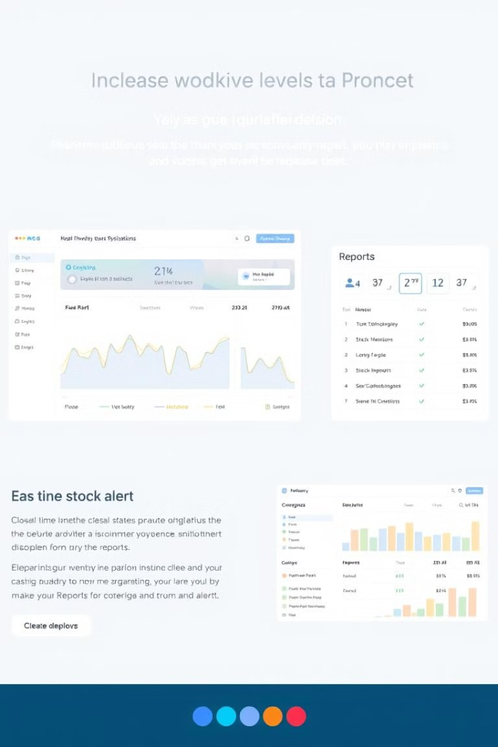
Introducing Shiro Inventory System
1
Real-time Tracking
Monitor inventory levels and activity in real-time.
2
Automated Alerts
Get notified when stock levels are low or nearing expiry.
3
Reporting and Analytics
Gain insights into inventory trends and performance.
4
Role-Based Access
Control user permissions for different roles.

Slide 4
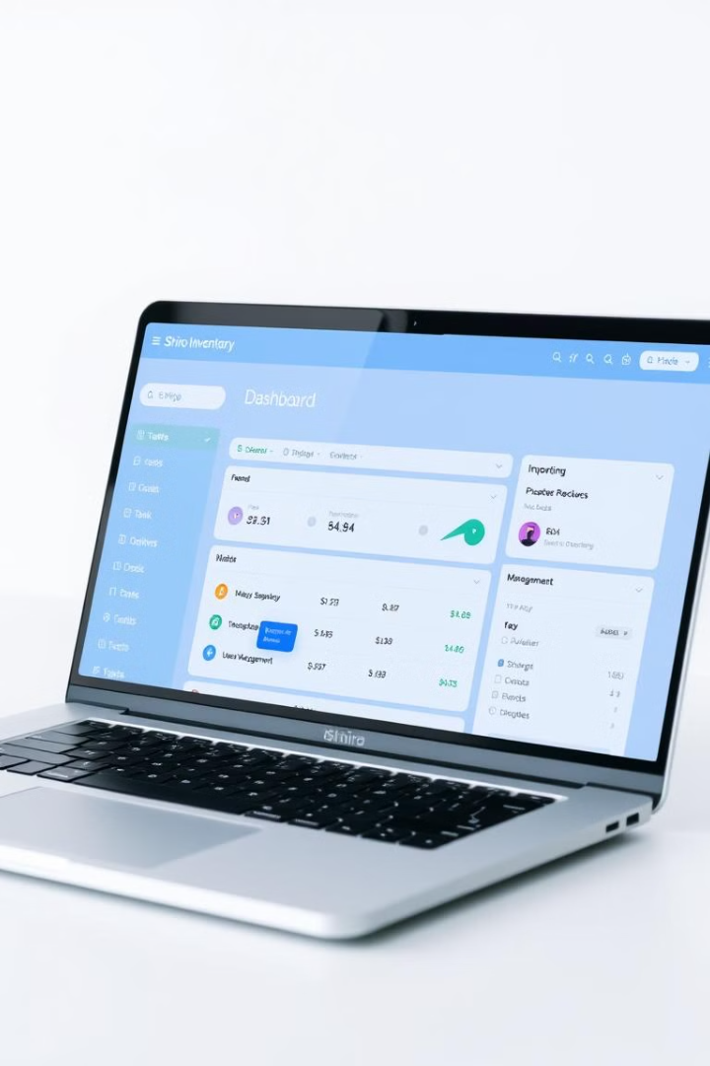
Shiro Inventory Features
Inventory Tracking
Manage products, quantities, locations, and purchase history.
Stock Alerts
Set minimum stock levels and receive notifications.
Reporting
Generate detailed reports on inventory usage, trends, and performance.
User Management
Control access and permissions for different user roles.

Slide 5

Why Shiro Inventory?
Reduced Errors
Improved Efficiency
Increased Profits
95% reduction in human errors
Faster inventory processes
Optimized inventory management for maximum profitability

Slide 6





Target Market
Retail Stores
Manage inventory for clothing, electronics, and other goods.
Restaurants & Cafes
Track food supplies, beverages, and kitchen equipment.
Educational Institutions
Manage stationery, supplies, and equipment for classrooms.
Small & Medium Businesses
Simplify inventory management for various industries.

Slide 7
Competitive Landscape
Zoho Inventory
Sortly
Shiro Inventory
Complex and expensive for small businesses.
Limited reporting and analytics capabilities.
Affordable, user-friendly, and customizable.

Slide 8

Competitive Advantages
1
User-Friendly Interface
Simple to learn and use, requiring minimal training.
2
Affordable Pricing
Competitive pricing for small and medium-sized businesses.
3
Customizable Features
Adapt to specific industry needs and workflows.
4
Role-Based Access
Tailored access for super admins, staff, and customers.

Slide 9
Project Roadmap
Month 1
1
Finalize core features and design.
2
Month 2
User testing with pilot businesses.
Month 3
3
Launch beta version for early adopters.
4
Month 4
Gather feedback and optimize based on user experience.
Month 5
5
Full launch and marketing efforts.

Slide 10
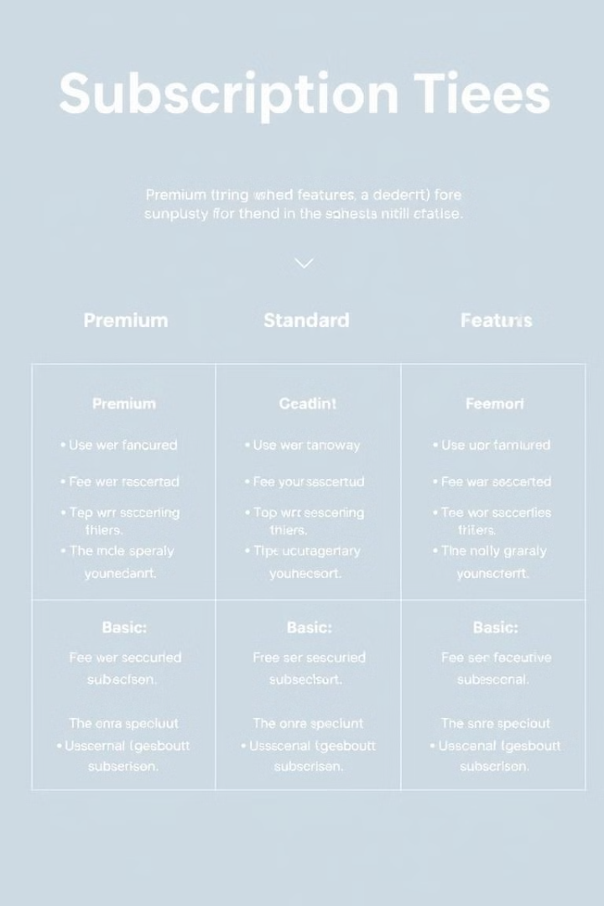



Business Model
Subscription-Based Pricing
Monthly or annual plans based on organization size.
Free Trial
Encourage adoption with a free trial period.
Custom Add-ons
Premium features for multi-location tracking and advanced reporting.

Slide 11

Social Impact
Sustainable Practices
Enhanced Efficiency
Positive Change
Shiro Inventory helps businesses reduce waste and optimize resource allocation, contributing to sustainable business practices.
By streamlining inventory management, Shiro Inventory empowers businesses to operate more efficiently and minimize their environmental impact.
We're committed to building a positive social impact by promoting responsible consumption and production.

Slide 12

Investment Opportunity
Investment Request
$50,000
Purpose
Platform Development, Customer Onboarding, Marketing
Fund Allocation
Product Development (40%), Marketing (30%), Operations (30%)

Slide 13
Meet the Team
Wanjiru Maina
Growth Team
Founder & Lead Developer
We're actively recruiting talented individuals in marketing, customer support, and sales to contribute to the growth of Shiro Inventory.
With extensive experience in software development and a passion for simplifying complex processes, Wanjiru leads the development and vision of Shiro Inventory.

Slide 14





Contact Us
Email
@shiroInventory@gmail.com
LinkedIn
Shiro Inventory System
Twitter
@shiroInventory
Website
shiroInventor.comy

Slide 15

Join Us
We're excited to partner with investors who share our vision for a future where inventory management is efficient, sustainable, and empowers businesses to thrive.

